Slide 1


Slide 2
Compiler Constructions
Zulfiqar Ali
FAST NUCES

Slide 3
Week 15 – Code Optimization
Intermediate Code Optimization

Slide 4
Types of Code Optimization:
The optimization process can be broadly classified into two types:
Machine Independent Optimization: This code optimization phase attempts to improve the intermediate code to get a better target code as the output. The part of the intermediate code which is transformed here does not involve any CPU registers or absolute memory locations.
Machine Dependent Optimization: Machine-dependent optimization is done after the target code has been generated and when the code is transformed according to the target machine architecture. It involves CPU registers and may have absolute memory references rather than relative references. Machine-dependent optimizers put efforts to take maximum advantage of the memory hierarchy.

Slide 5
Different ways of Code Optimization
Compile Time Evaluation
Variable Propagation
Constant Propagation:
Constant Folding
Copy Propagation
Common Sub Expression Elimination
Dead Code Elimination
Unreachable Code Elimination
Function Inlining
Function Cloning
Strength Reduction
Loop Optimization Techniques

Slide 6
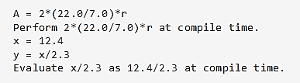
Compile Time Evaluation

Slide 7
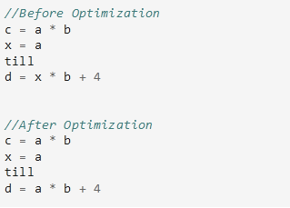
Variable Propagation

Slide 8
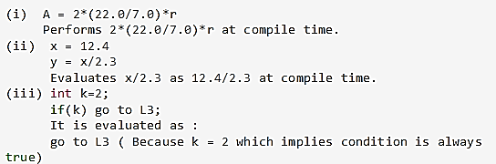
Constant Propagation:
If the value of a variable is a constant, then replace the variable with the constant. The variable may not always be a constant.

Slide 9
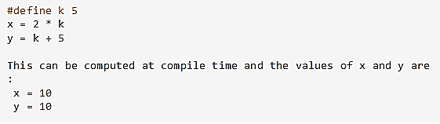
Constant Folding
Consider an expression : a = b op c and the values b and c are constants, then the value of a can be computed at compile time.

Slide 10
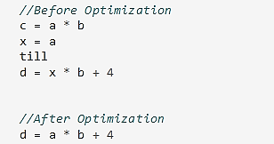
Copy Propagation
It is extension of constant propagation.
After a is assigned to x, use a to replace x till a is assigned again to another variable or value or expression.
It helps in reducing the compile time as it reduces copying.

Slide 11
Common Sub Expression Elimination
In the following example, a*b and x*b is a common sub expression.

Slide 12
Dead Code Elimination
The statements of the code which either never executes or are unreachable or their output is never used are eliminated.
In order to find the dead variables, a data flow analysis should be done.
Code Before Optimization | Code After Optimization
i = 0 ; if (i == 1) { a = x + 5 ; } | i = 0 ;

Slide 13
Function Inlining:
Here, a function call is replaced by the body of the function itself.
This saves a lot of time in copying all the parameters, storing the return address, etc.

Slide 14
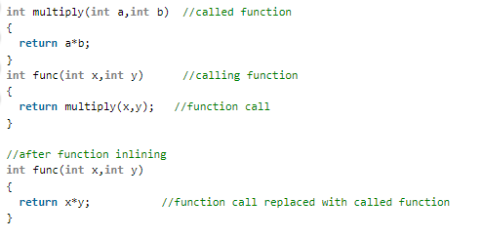

Slide 15
Function Cloning
Here, specialized codes for a function are created for different calling parameters.
Example: Function Overloading

Slide 16
Strength Reduction
Strength reduction means replacing the high strength operator with a low strength.
Code Before Optimization | Code After Optimization
B = A x 2 | B = A + A

Slide 17
Loop Optimization Techniques
Code Motion or Frequency Reduction
The evaluation frequency of expression is reduced.
The loop invariant statements are brought out of the loop.

Slide 18
Target Code Generation
Target code generation is the final Phase of Compiler.
Input : Optimized Intermediate Representation.
Output : Target Code.
Task Performed : Register allocation methods and optimization, assembly level code.
Method : Three popular strategies for register allocation and optimization.
Implementation : Algorithms.

Slide 19
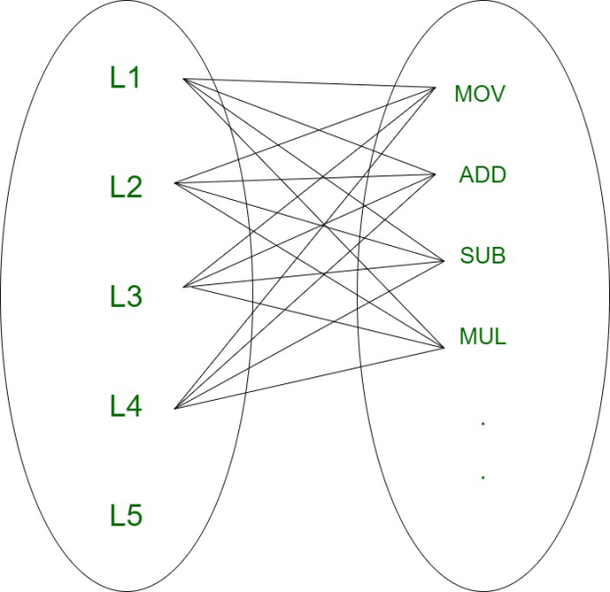
Target code generation deals with assembly language to convert optimized code into machine understandable format. Target code can be machine readable code or assembly code. Each line in optimized code may map to one or more lines in machine (or) assembly code, hence there is a 1:N mapping associated with them .

Slide 20
Computations are generally assumed to be performed on high speed memory locations, known as registers. Performing various operations on registers is efficient as registers are faster than cache memory. This feature is effectively used by compilers, However registers are not available in large amount and they are costly. Therefore we should try to use minimum number of registers to incur overall low cost.

Slide 21
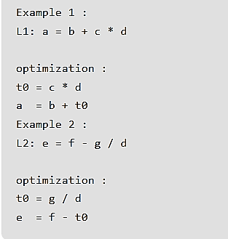
Optimized code

Slide 22
Register Allocation
Register allocation is the process of assigning program variables to registers and reducing the number of swaps in and out of the registers. Movement of variables across memory is time consuming and this is the main reason why registers are used as they available within the memory and they are the fastest accessible storage location.

Slide 23
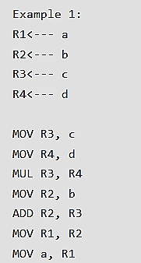
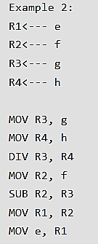
Register Allocation

Slide 24
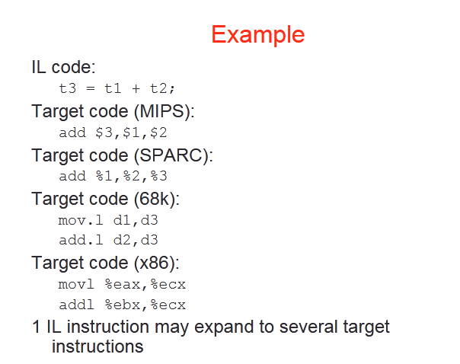

Slide 25
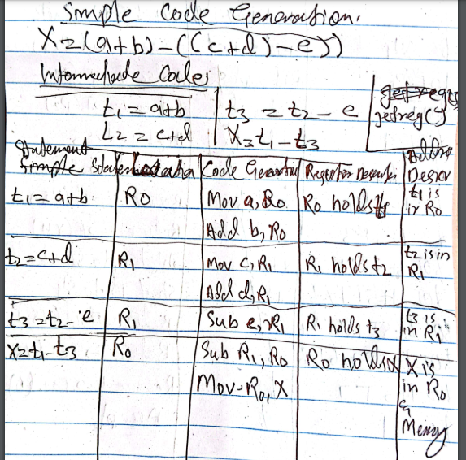

Slide 26
Reference
Compilers: Principles, Techniques, and Tools, A. V. Aho, R. Sethi and J. D. Ullman, Addison-Wesley, 2nd ed., 2006.
https://www.geeksforgeeks.org/target-code-generation-in-compiler-design/

Slide 27
THANK YOU

